Slide 1
CAS 2022 Awards Program WINNERS

Slide 2
For more than half a century, we have made it our mission to recognize, promote and foster excellence in anesthesia through our award programs.

Slide 3
HONOUR AWARDS

Slide 4
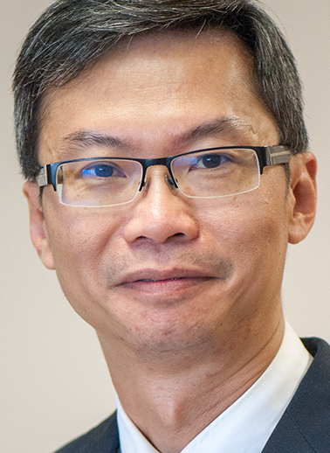
Gold Medal
Dr Philip Peng
Given in recognition of sustained excellence as a clinician, researcher and educator, and dedication to advancing the science and understanding of anesthesia.

Slide 5
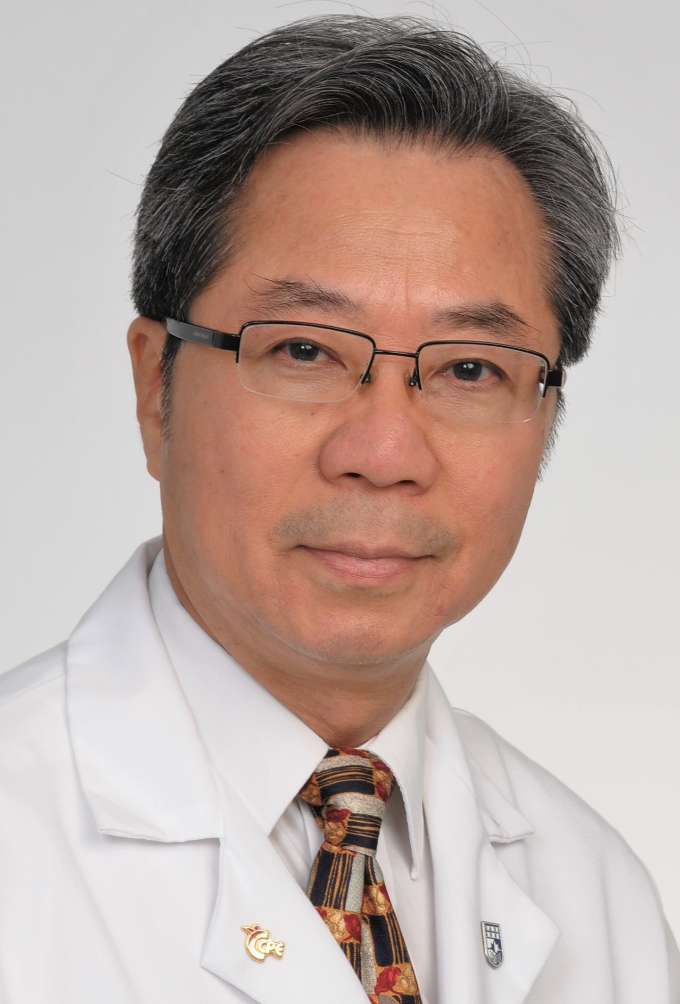
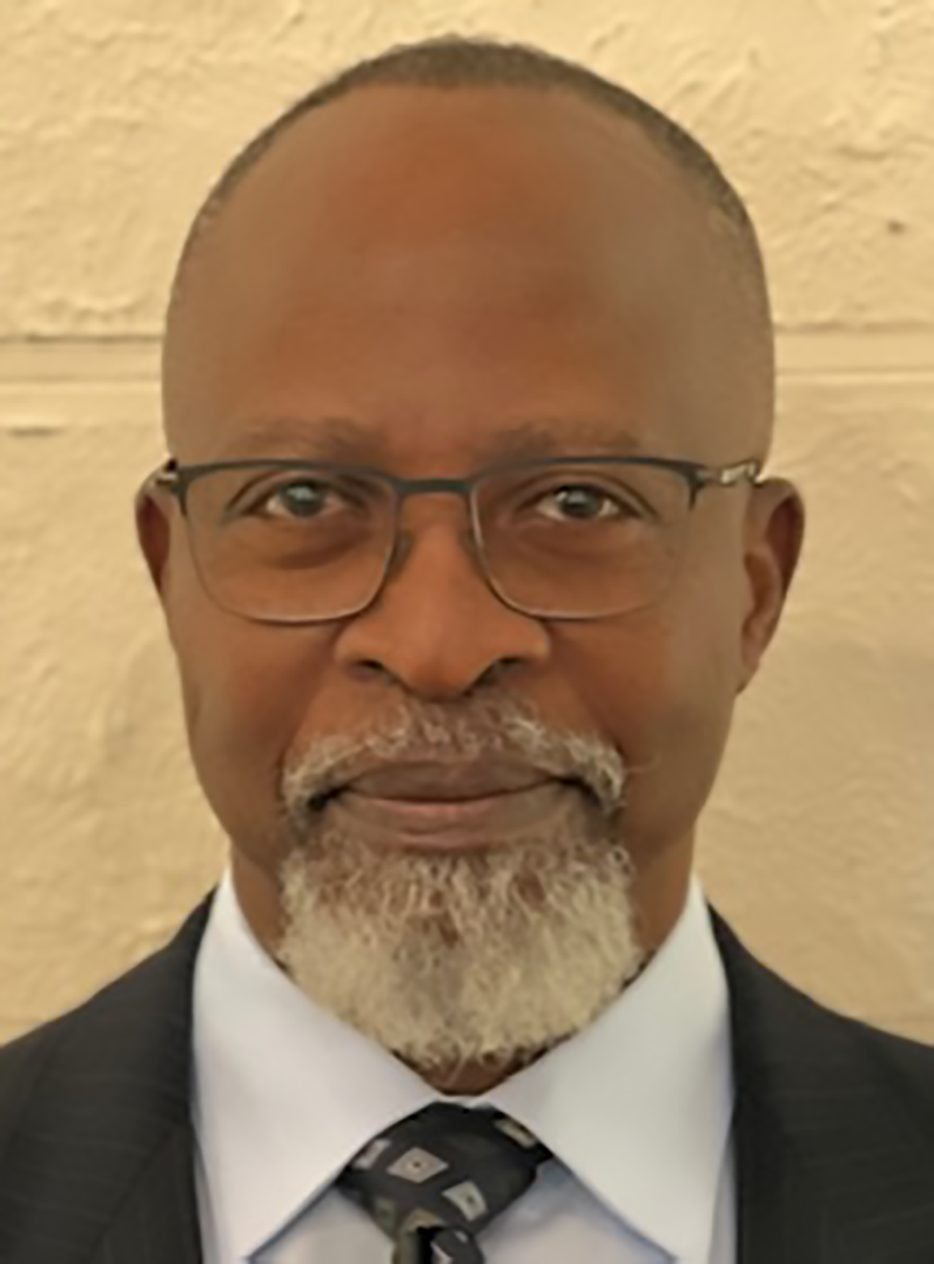
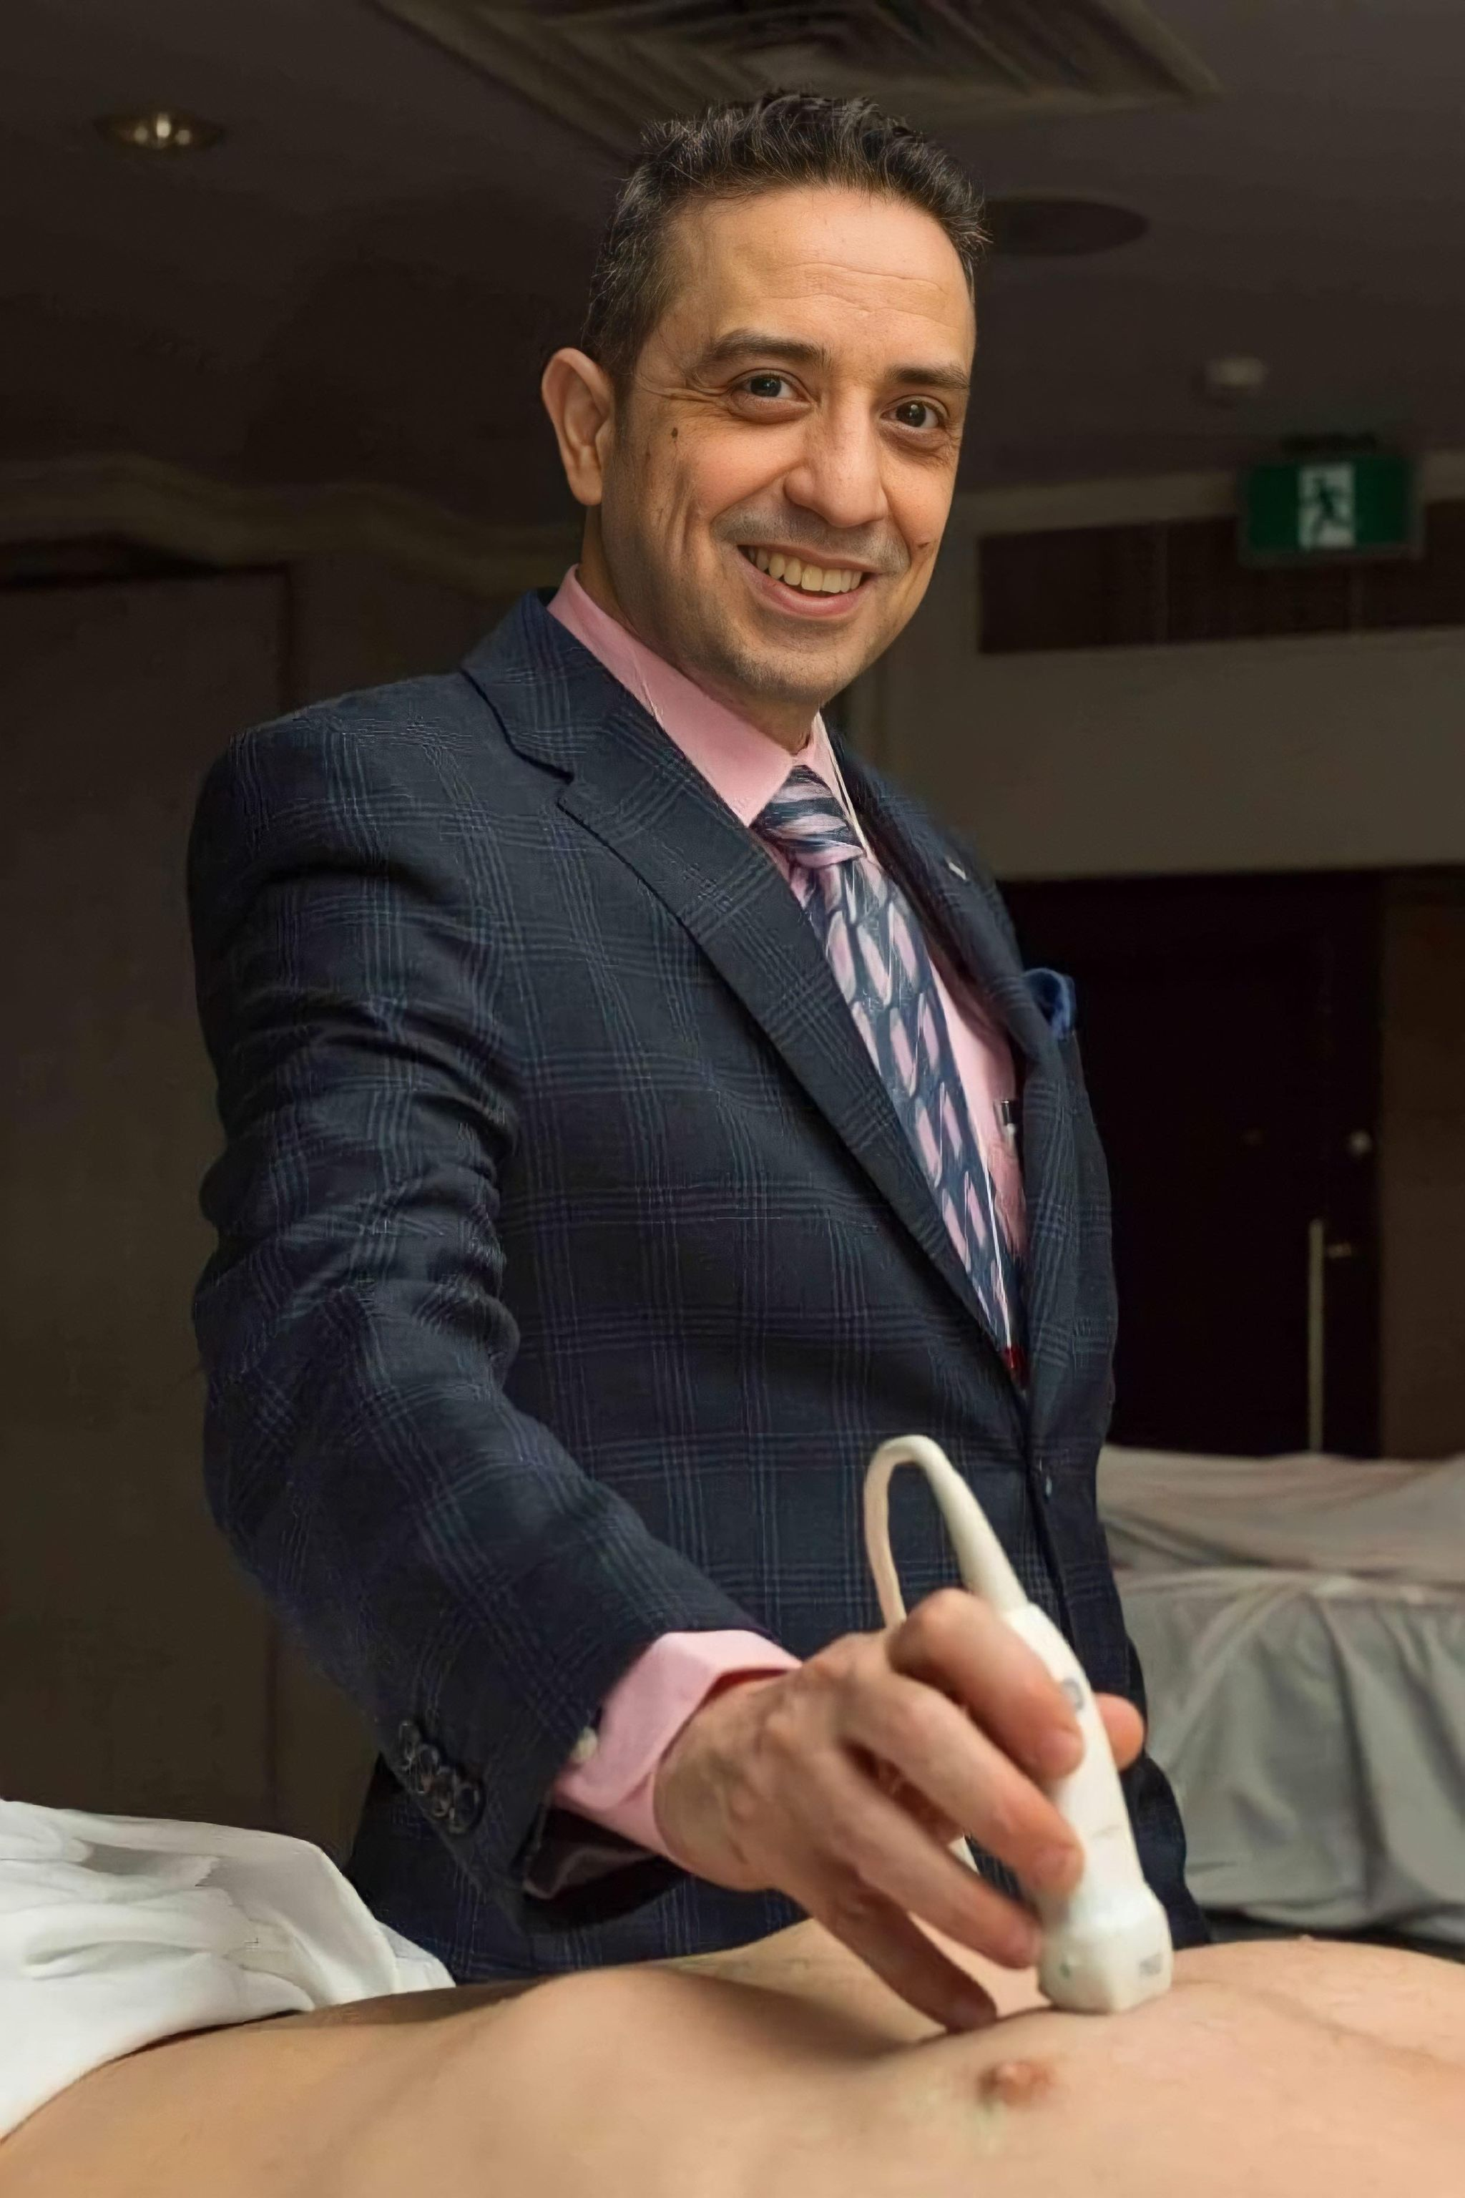
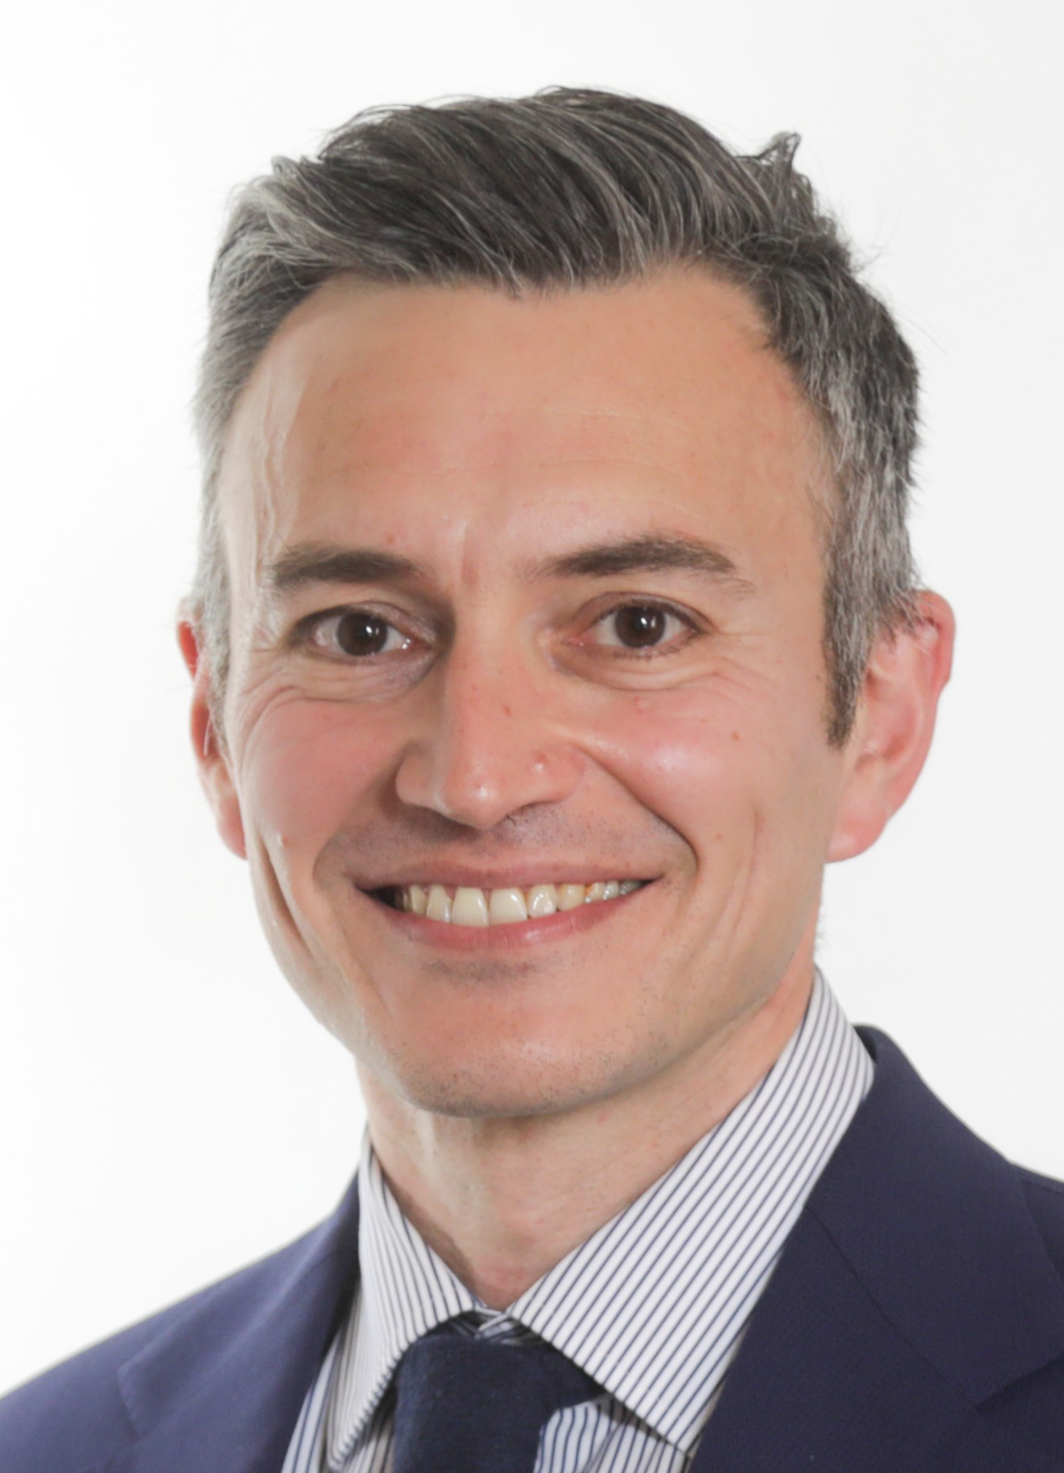
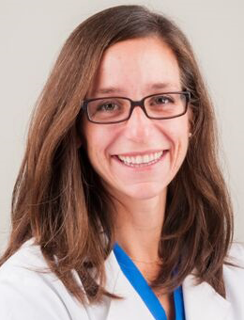
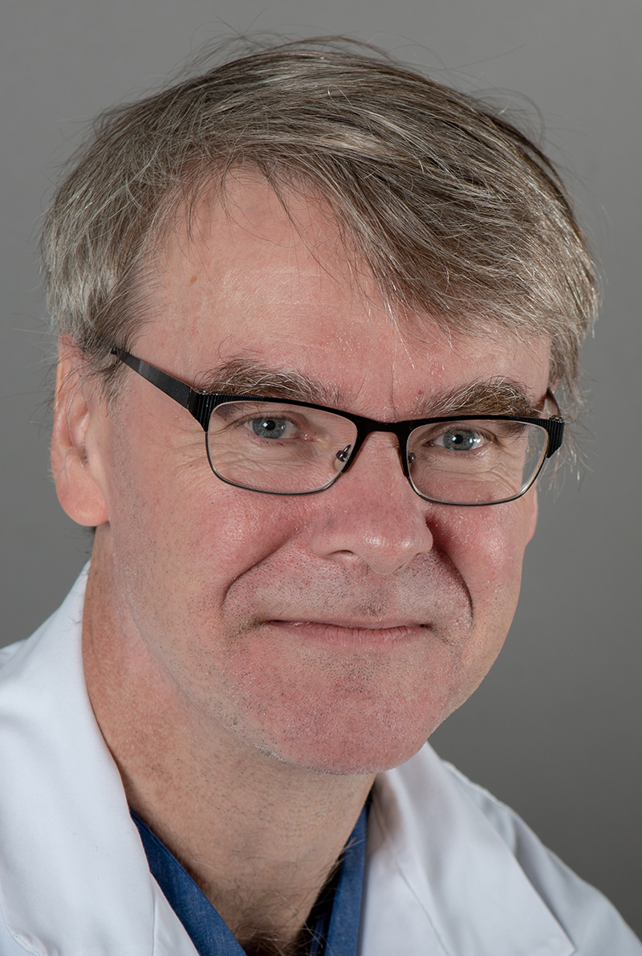
Emeritus Award
Humanitarian Award
Clinical Teacher Award
Clinical Practitioner Award
John Bradley Young Educator Award
Research Recognition Award
Dr Devy Cheng
London, ON
Dr Alezandre Dauphin
Hamilton, ON
Dr Hesham Talab
Ottawa, ON
Dr Gabriele Baldini
Montreal, QC
Dr Natalie Clavel
Toronto, ON
Dr André Denault
Montreal, QC

Slide 6
Outstanding Volunteer Award
Given in recognition of excellence in supporting CAS through volunteering.

Slide 7
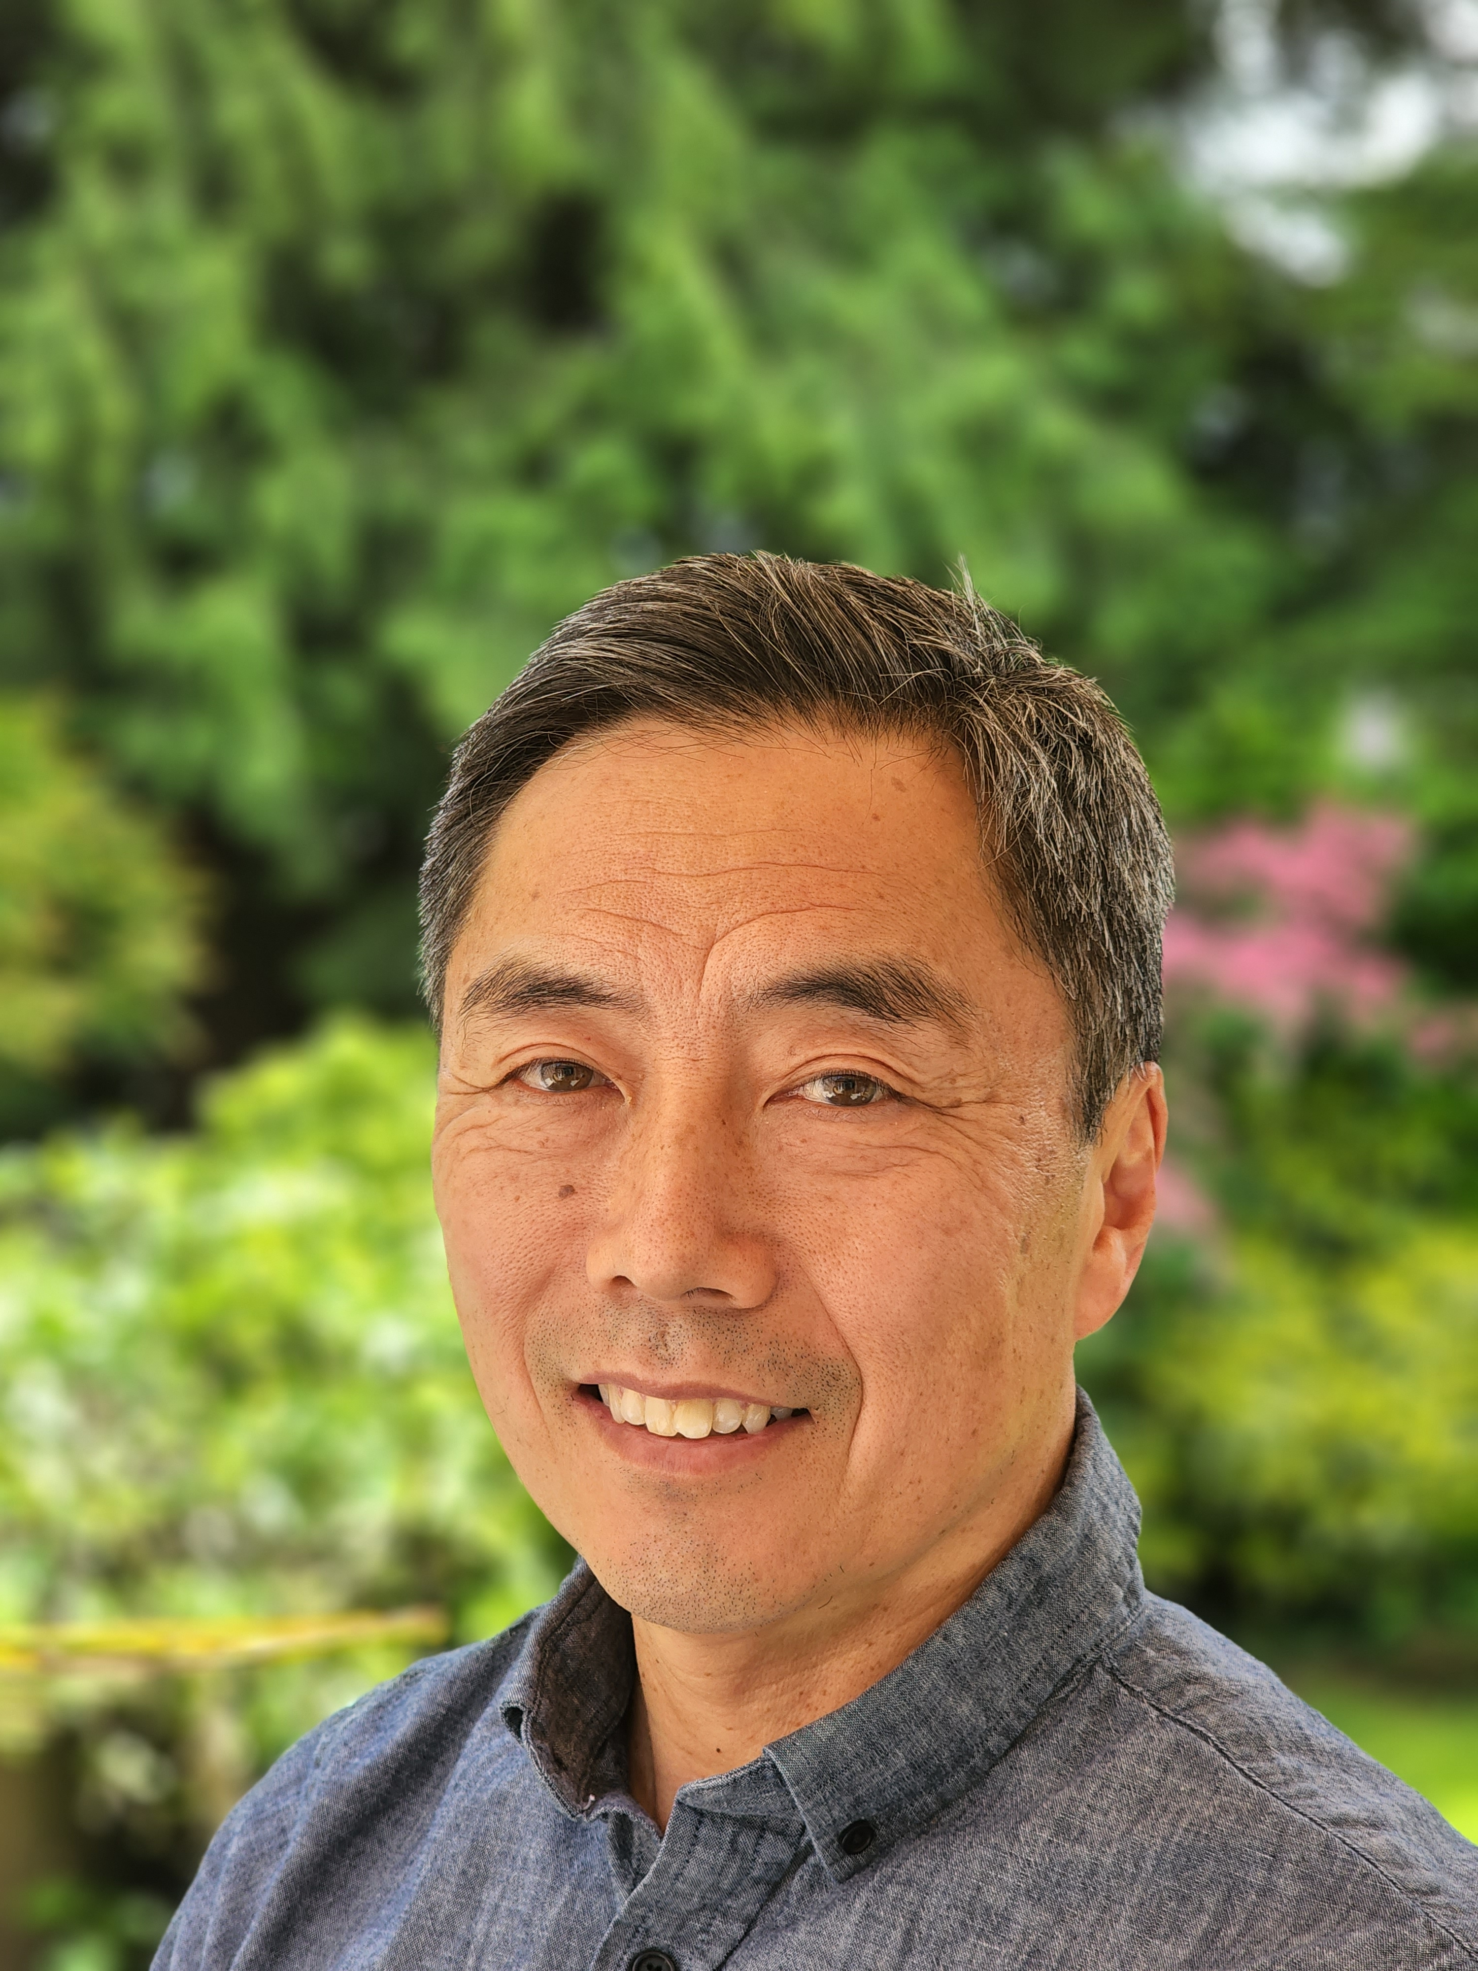
Outstanding Volunteer Award
Given in recognition of excellence in supporting CAS through volunteering.
Dr Doreen Yee
Toronto, ON
Dr James Kim
Vancouver, BC

Slide 8
RESEARCH PROGRAM

Slide 9
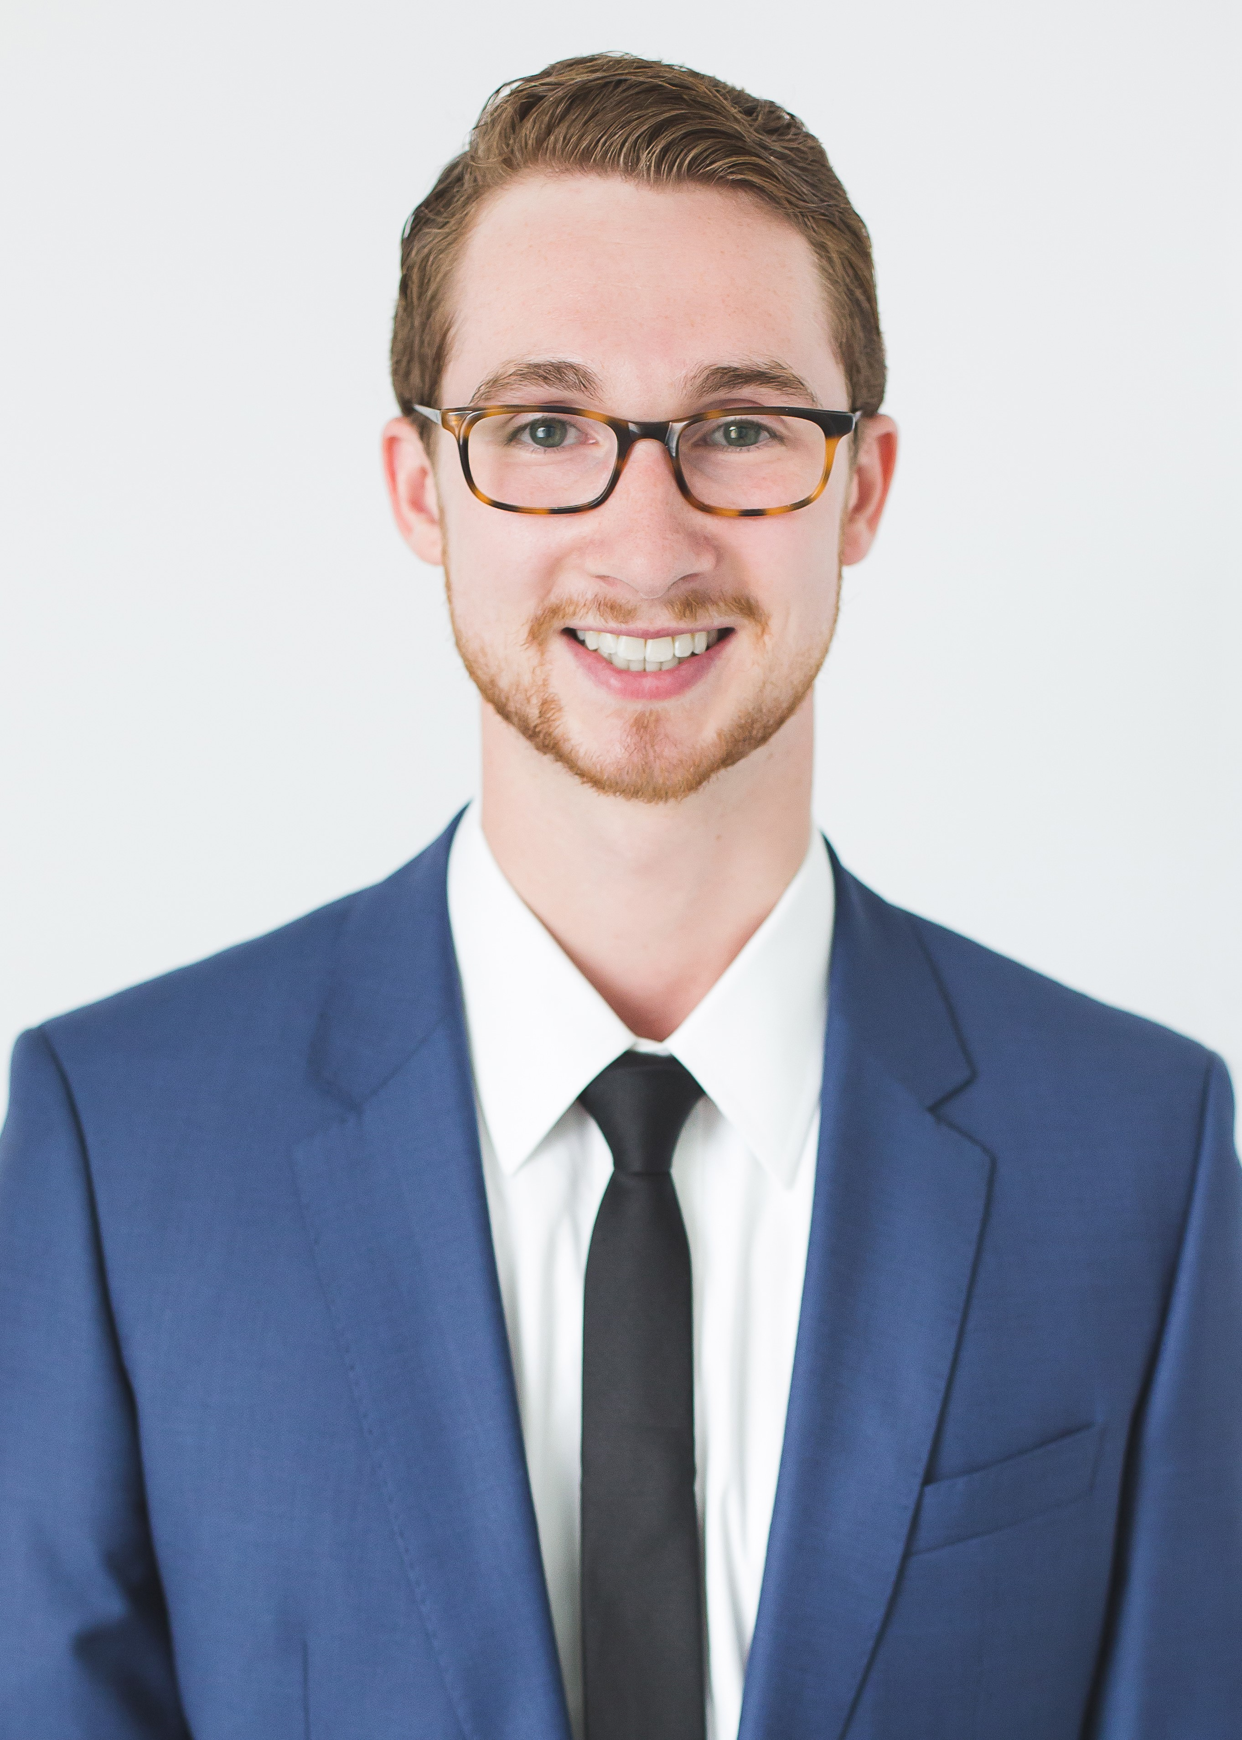
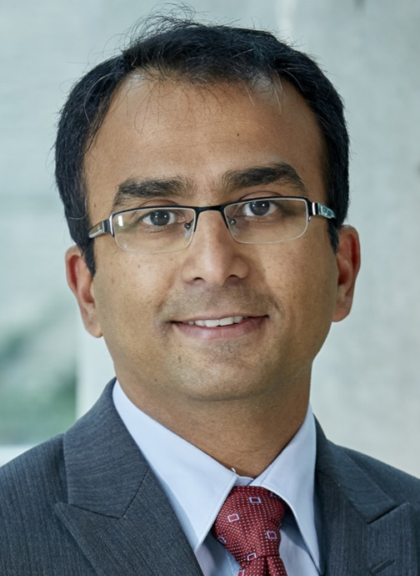
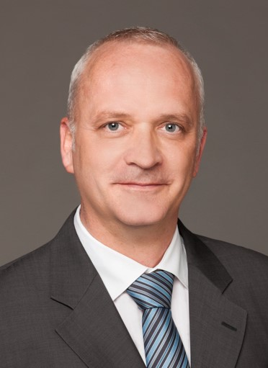
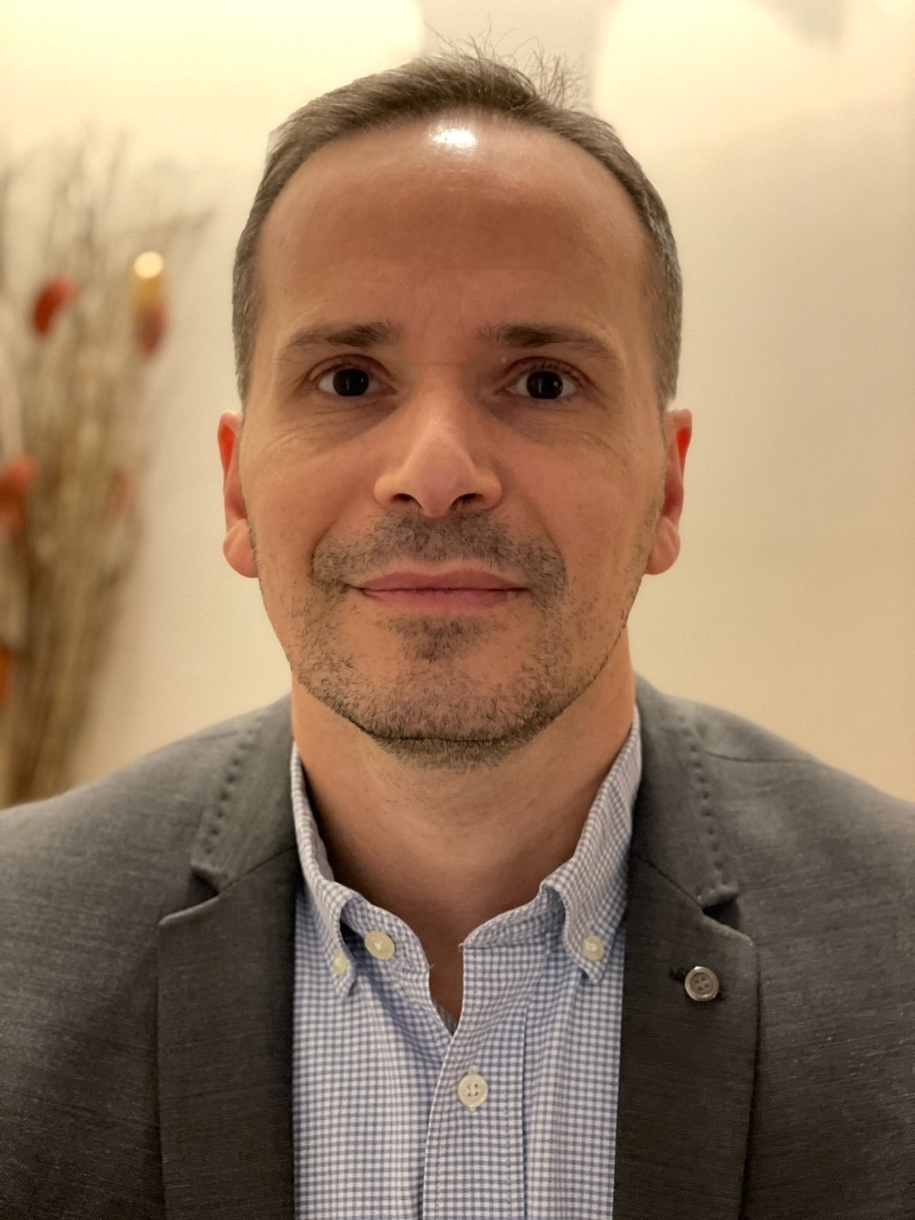
New Investigator Grants
Open Grants
Ontario's Anesthesiologists - CAS Residents' Research Grant
Canadian Anesthesiologists’ Society Research Award
Dr Earl Wynands Research Award
Dr James Beckstead Award – NEW
Dr R A Gordon Research Award
CAS Research Award in memory of Adrienne Cheng
CAS Career Scientist Award
Dr John Peel
Toronto, ON
Dr Kazuyoshi Aoyama
Toronto, ON
Dr Michael Sklar
Toronto, ON
Dr Harsha Shanthanna
Hamilton, ON
Dr Philippe Richebé
Montréal, QC
Dr David Ogez
Montréal, QC
Dr Manoj Lalu
Ottawa, ON

Slide 10
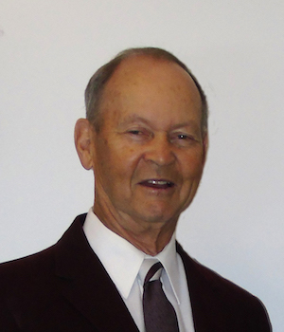
Dr James Beckstead
Thank you for your generosity!

Slide 11
BEST ABSTRACT AWARDS

Slide 12
Best Abstract Award in Ambulatory Anesthesia
London, ON
Best Abstract Award in Chronic Pain
Toronto, ON
Best Abstract Award in Obstetric Anesthesia (anesthesiologists)
Toronto, ON
Best Abstract Award in Obstetric Anesthesia (residents/medical students)
Halifax, NS
Best Abstract Award in Periperative Medicine
Toronto, ON
Best Paper Award in Regional Anesthesia and Acute Pain
Montreal, QC
CAS Critical Care Medicine Award
Montréal, QC
Ian White Patient Safety Award
Toronto, ON
Dr Tripti Nagdev
Dr Maggie Xiao
Dr Natalia Portela
Dr Brendan Morgan
Dr Paula Perez
Dr Maxime Caron-Goudreau
Dr Louis Morisson
Dr Tariq Esmail

Slide 13
MEDICAL STUDENT ESSAY COMPETITION

Slide 14
First Place
Michael Paille
Winnipeg, MB
Second Place
Dmitry Neymark
Richmond Hill, ON
Third Place
Bridgette Chan
Halifax, NS

Slide 15
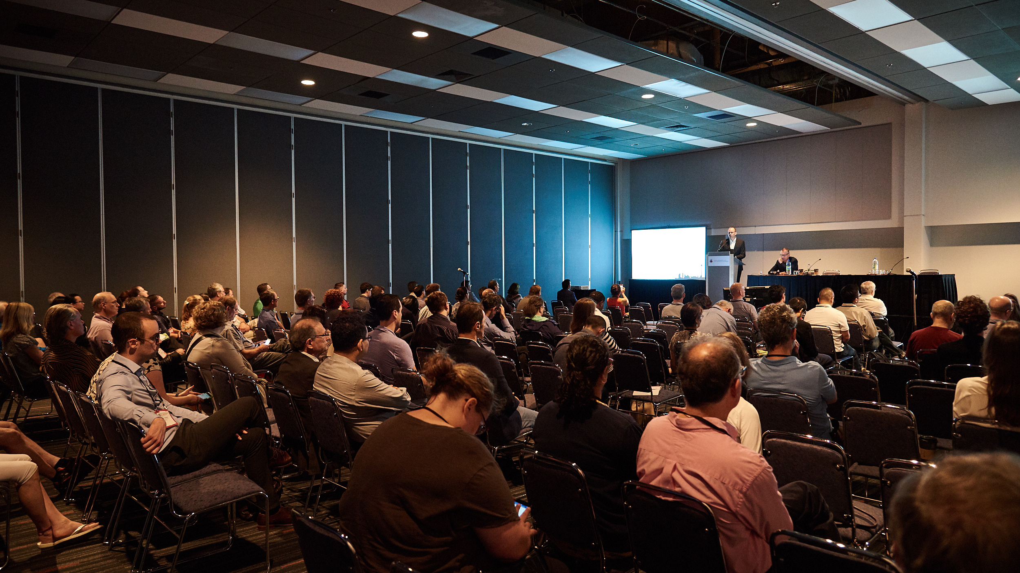
ON-SITE COMPETITIONS & AWARDS

Slide 16
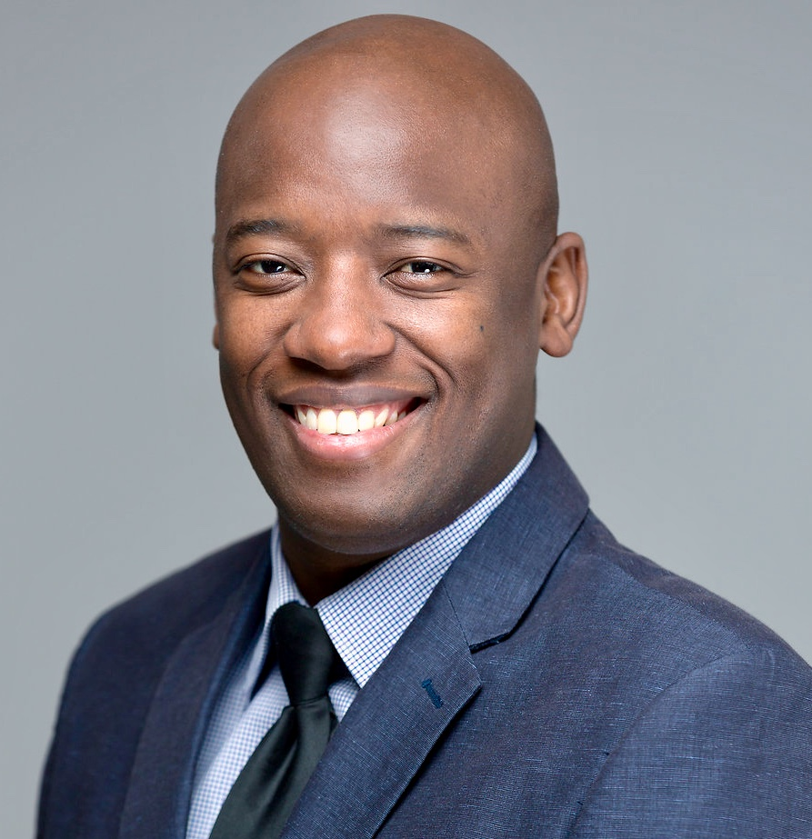
Richard Knill Research Oral Competition
Clyde Matava
“An International Multicenter Observational Study of Patient and Process Outcomes among 3302 Pediatric Patients Undergoing Appendectomy During the COVID-19 Pandemic”

Slide 17
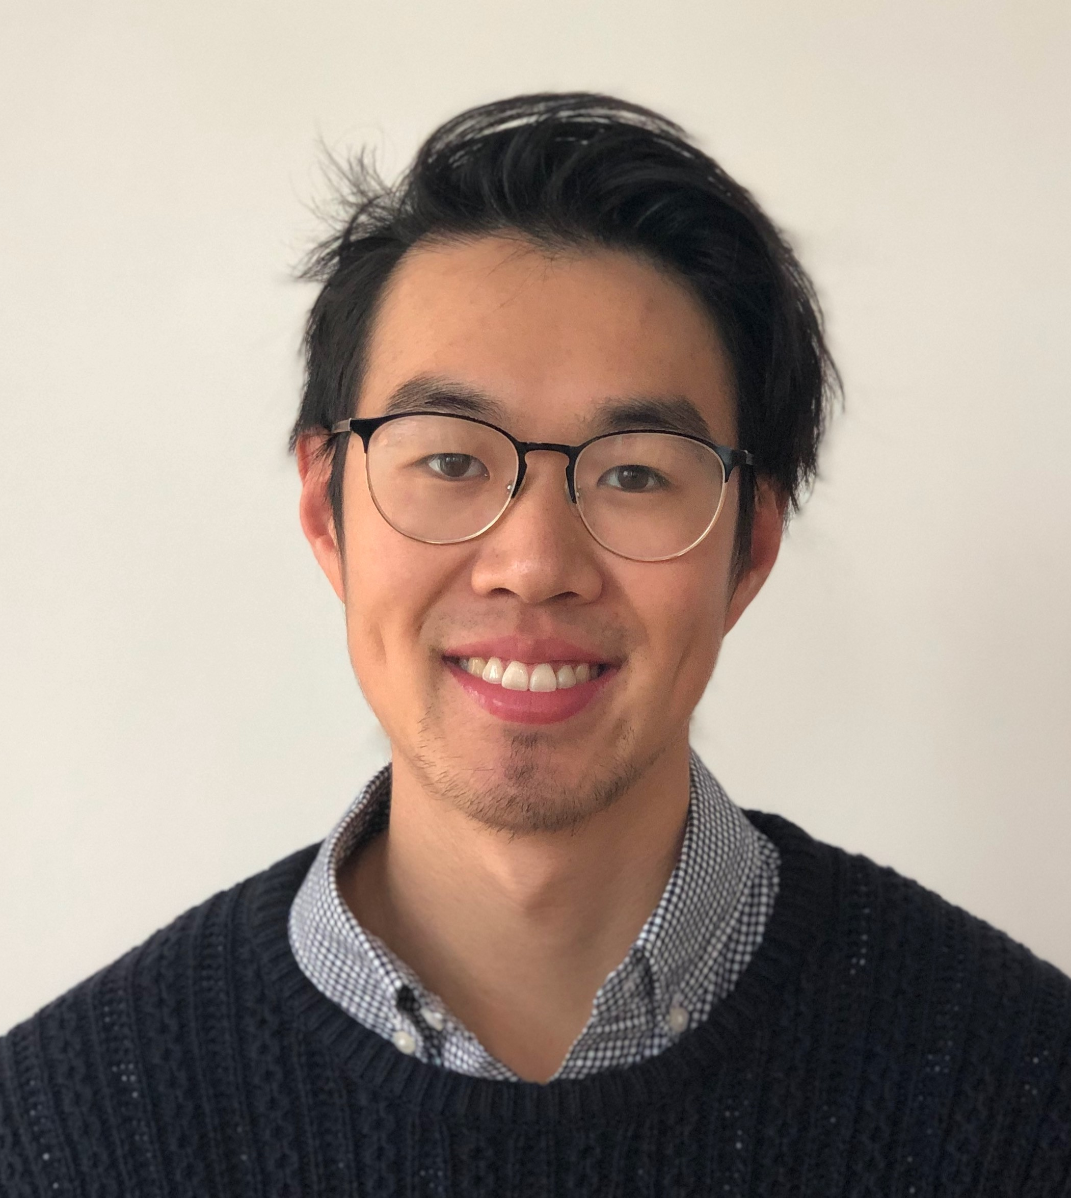
Residents’ Oral Competition
Chenchen Tian , University of Toronto
“Level of evidence of perioperative guidelines for patients with obstructive sleep apnea: an evaluation using the Appraisal of Guidelines for Research and Evaluation II (AGREE II) tool ”

Slide 18
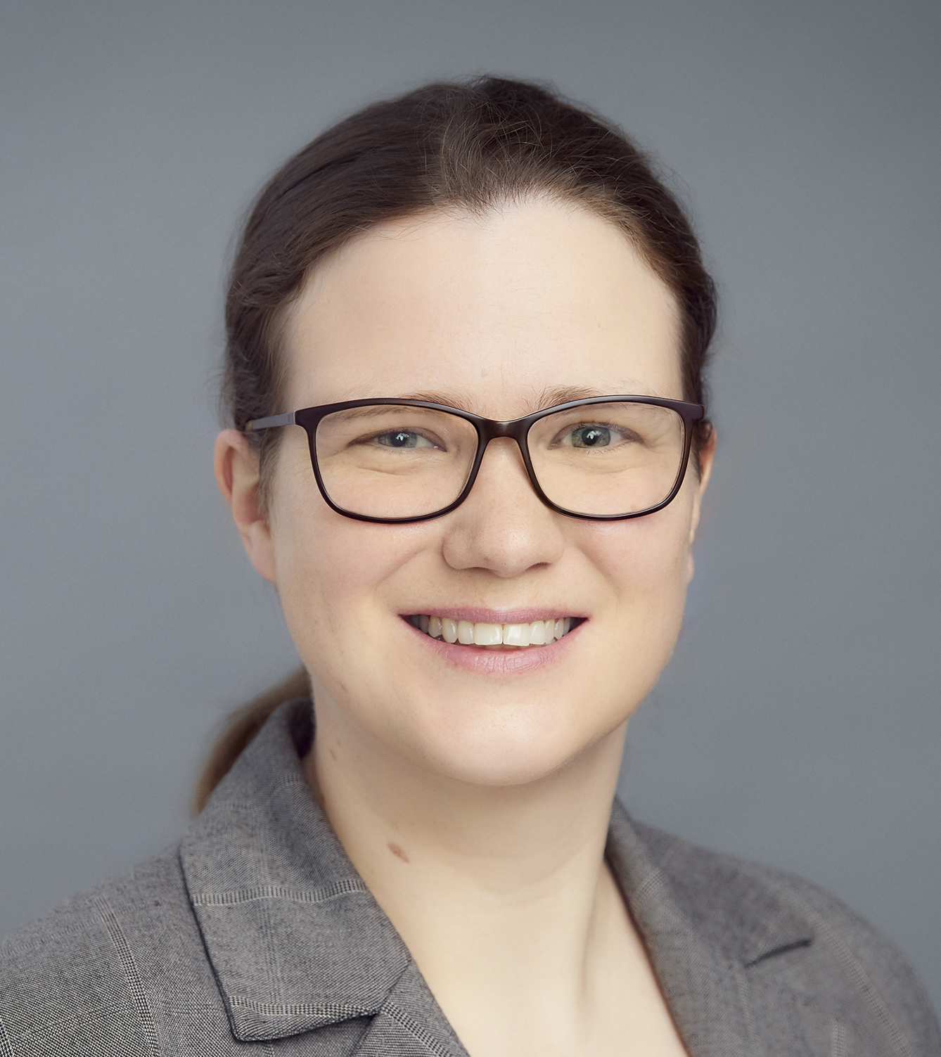
Award for Best Abstract in Education and Simulation in Anesthesia
Sabine Nabecker
Education & Simulation - Deception in simulation and its effects on the learner – a qualitative study

Slide 19
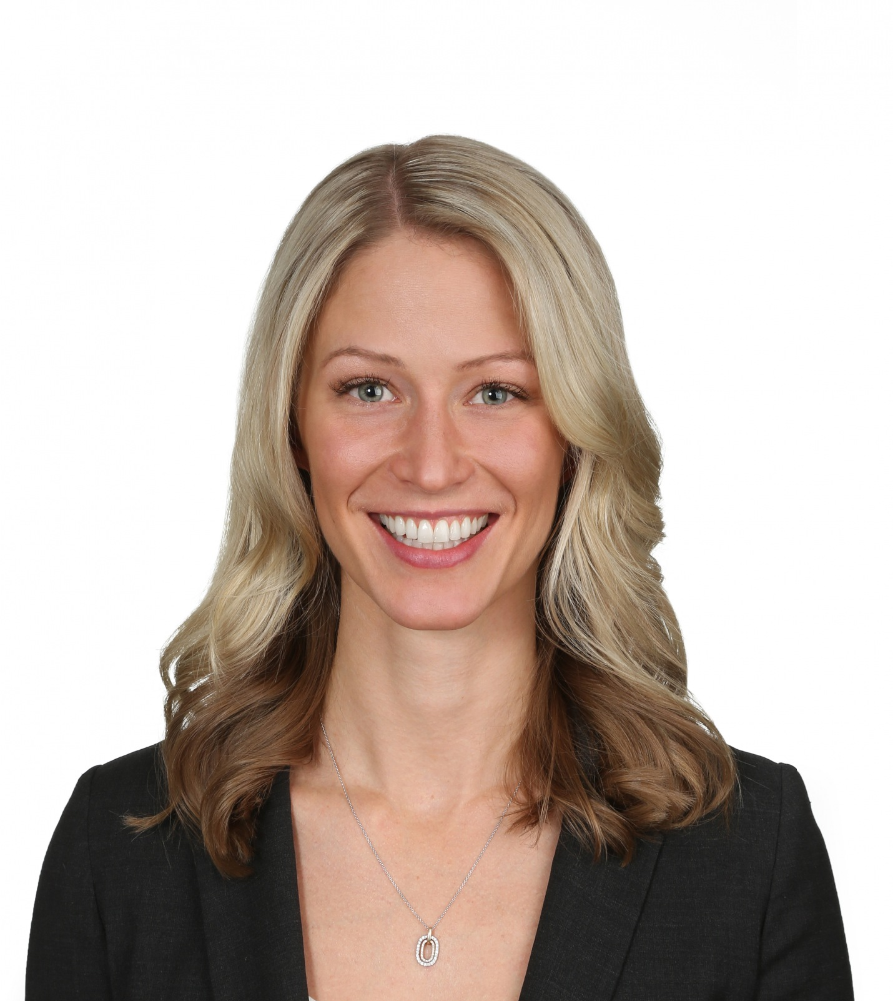
Award for Best Paper in Pediatric Anesthesia
Katherine Impey, University of Alberta
“Total IV versus Volatile Anesthetic for Pediatric Tonsillectomies and the Incidence of Perioperative Respiratory Adverse Events: A Cohort Study (TIVA Study)”

Slide 20
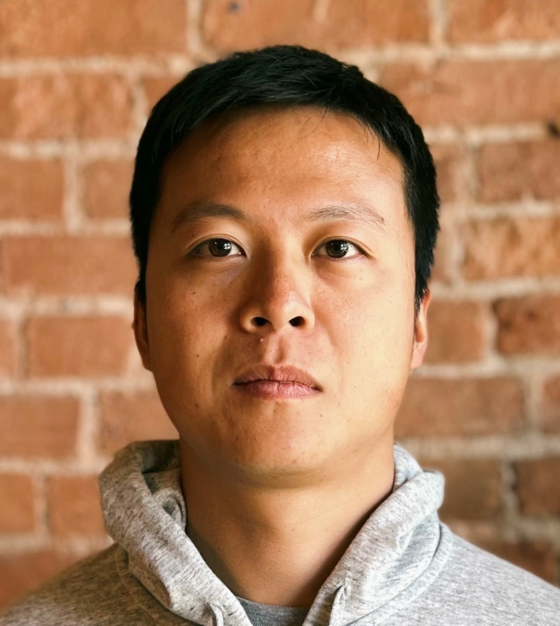
CVT Raymond Martineau Prize
Kyle Chin
“Nephrectomy Negatively Impacts Physiological Mechanisms That Maintain Rat Brain Oxygenation Following Acute Hemodilutional Anemia”

Slide 21
Thank you to our Volunteer Judges & Supporters!
On-Site Competitions
Scientific Affairs Subcommittee
Competition Judges: from ACUDA and the Canadian Journal of Anesthesia Editorial Board
the Cardiovascular Thoracic Section
Pediatric Section
Education and Simulation in Anesthesia Section
Honour Awards
Awards Committee & Outstanding Volunteer Award Subcommittee
Research Awards
Research Advisory Committee
Canadian Anesthesia Research Foundation (CARF) and all donors
Ontario’s Anesthesiologists
Best Papers
Scientific Affairs Subcommittee
Quality and Patient Safety Committee
CAS Sections
Medical Student Essay
Dr Carol Loffelmann, judges, undergraduate coordinators and representatives

